Slide 1

Sustainable shopping of tomorrow – Schwartz IT
Herhackathon 22
Group name: Retail Ninjas
Group members: Petya Marinova
Mikaela Karamitro
Thi Hai Yen Nguyen
Kata Borsi - Speaker

Slide 2
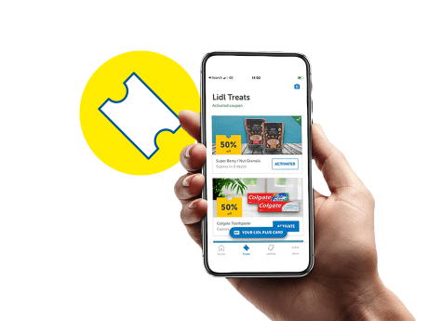
Idea generation
Today’s shoppers care about the environment and want to use businesses that are aligned with their personal values and beliefs
How could we work with sustainability & personalised digital experiences?
Notes:
Source: https://www.saveonethird.org/
Today’s consumers are environmentally conscious

Slide 3
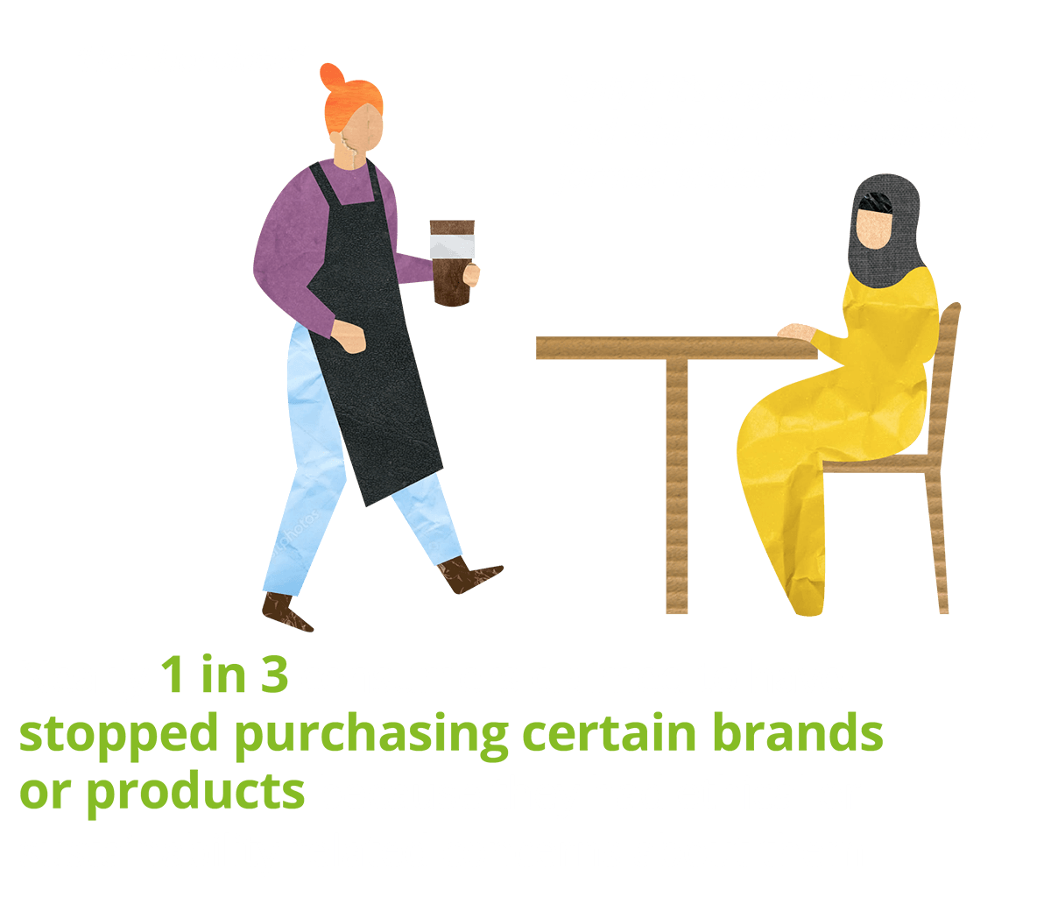
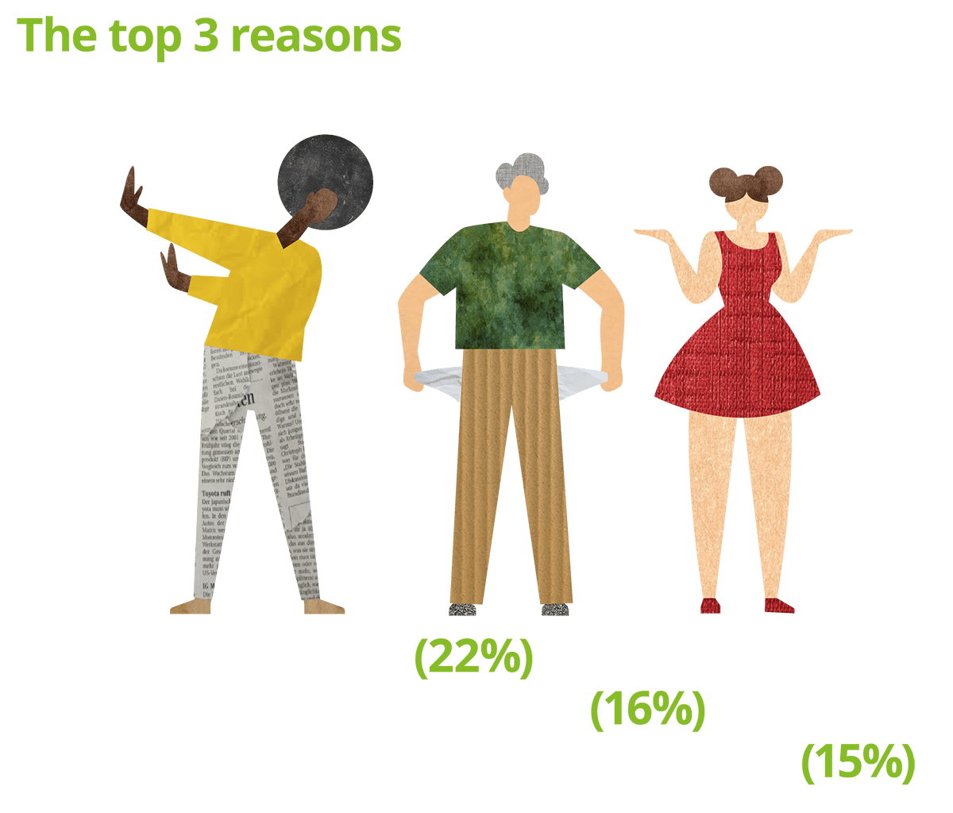
Notes:
Deloitte, 2021
https://www2.deloitte.com/uk/en/pages/consumer-business/articles/sustainable-consumer.html
The more data Lidl collects about a customer through an app, the more personalised the experience can be
People seek tailored and smooth shopping experiences

Slide 4
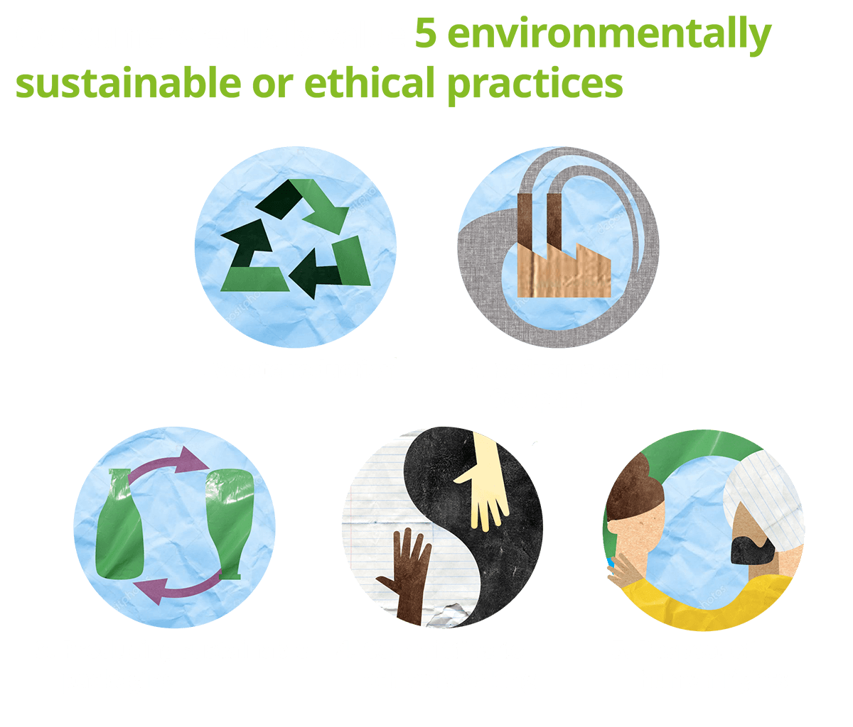
Notes:
Deloitte, 2021
https://www2.deloitte.com/uk/en/pages/consumer-business/articles/sustainable-consumer.html

Slide 5
Idea generation
The nr. 1 valued sustainability practice by consumers is waste reduction (44% - Deloitte)
1/3 of the world’s food is wasted
Reducing food waste is beneficial to the business and the consumer
Consumers want to have personal and sustainable shopping experiences in the future
Notes:
Source: https://www.saveonethird.org/
Today’s consumers are environmentally conscious

Slide 6
The Idea: Personalisation & sustainability in the Lidl Plus app

Slide 7
Personalisation:
Persona in the app
Build your persona in the Lidl app to get personalised coupons and recipes recommended for you
Additional data collection & machine learning
The app learns your shopping habits and food preferences based on purchase history
The recommendations and coupons become even more targeted

Slide 8
Sustainability:
Reducing food waste through the Lidl app
Push notifications on reduced products
Discounted products in local store appear in the app
Push notification to people in the area about the product and reduction
Based on profile and preferences – personalised and relevant

Slide 9
Implementation (only food waste part):
Backend API (spring boot/nodedjs)
Redis (implemented through docker)
Frontend React app integrated with Push notifications

Slide 10
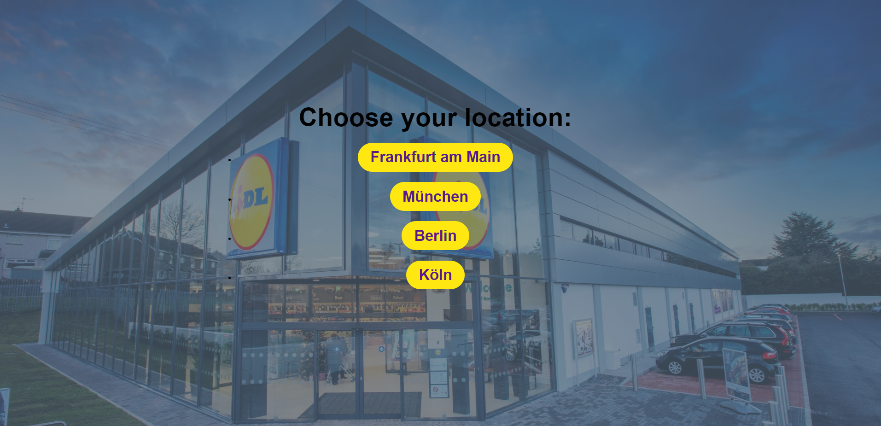

Implementation – main page

Slide 11
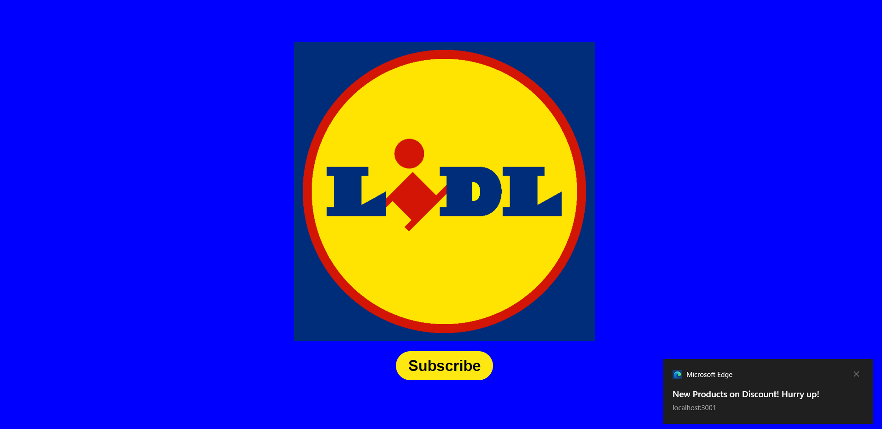
Implementation – push notification

Slide 12
Benefits
Customer benefits:
Reduced food waste (cost & environment)
Personalised app experience
Saves time on shopping
Business benefits:
Reduced food waste (cost & environment)
More customer data
More app downloads and use
More frequent store visits

Slide 13

Thank you!

